Slide 1


SpotyPY
Presentation of our work for the STAT4ACSAI 21-22 course’s project
Yusupha Juwara
Benjamin Barda
FrancescoDanese

Slide 2
Overview
For this project we decided to dive deep into some of the many models and tools seen during the duration of the course.
We decided that, given our shared passion for music, focusing on this field would be the perfect match of pleasure and “duty”.
During this brief presentation we present both the challenges and the result we had, in addition to future additions.
For the full repository of this project visit our public github repository.

Slide 3
The process
We could divide the journey of this project into 3 main phases :
Data gathering
Implementation from scratch
Exploring the results

Slide 4
Data gathering
It was always clear to us that trying to analyse the whole spectrum of existing genres was going to be too big of a task for our limited resources and we were fearing that nothing meaningful would stem out of this approach.
For the reason mentioned above we decided to limit ourselves to four genres, that in our opinion have both similarities and differences with respect to one another :
Jazz
Metal
Rap
Classical

Slide 5
Data gathering
Once defined the scope of the project we started gathering data. Our first idea was to use the Librosa package in order to extract features from audio files. This proved to be unfeasible indeed given that downloading huge amount of audio-files, and label them, was an effort out of reach for us.
As an alternative we used the Spotify API, which provide among many things, precomputed features for each song, making the data gathering process faster. Of course we had accepted a trade-off given the fact that the Librosa analysis is much more exhaustive than the features provided by Spotify.

Slide 6
Data gathering
On top of being simpler to store and retrieve, the Spotify precomputed features are “human understandable” and a more detailed explanation is provided in the Spotify developer guide. The ones we considered were :
Mood related : Danceability, Valence, Energy, Tempo
Loudness, Speechiness, Instrumentalness
Context related: Liveness, Acousticness

Slide 7
Data gathering
In order to build the dataset we downloaded the features appearing in the top Playlists for each one of the genres allowing us to quickly have labelled data.
After grouping them and cleaning the data frames from missing values and duplicates, we found ourselves with around 1300 datapoints. Which we considered a size good enough to be able to process it with ease on our modest machines.

Slide 8
Implementation Part

Slide 9
Once data has been gathered we decided that it was going to be academically beneficial to code our own models from scratch, trying to avoid as much as possible to use pre-computed modules.
To make it a fair mix of parametric vs non-parametric, classifications vs clustering algorithm we decided to implement the following.
Random forests
K-means (++)
MoG (EM)
GNB
Linear and logistic regression models.

Slide 10
We will not dive deep into the math of each model since this is presented both in the notebooks as well as in the report.
We think that would be more interesting for the audience to look at the results instead and provide a comparison on the performance of the different models
Now to the MODELs

Slide 11
Decision trees
Decision trees are well known tools used for classification as well as for regression.
Our implementation of the decision Tree uses the Information gain as the objective function.
We trained the Tree on a 75/25 split for training and evaluation giving us on average an accuracy of 86%.
The main purpose was for this implementation to be the base of our random forest.

Slide 12
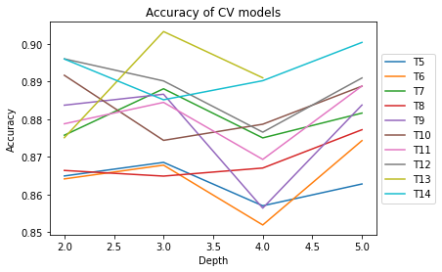
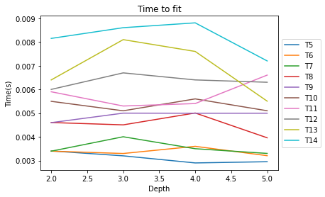
Having implemented the random forest we decided that it was the perfect opportunity to apply some model selection techniques.
We performed a 10-fold cross validation tuning both the maximum depth of the trees as well as their number in grid search approach.

Slide 13
K-MEANS, KMEANS++
Clustering is one of the most common exploratory data analysis techniques used to get an intuition about the structure of the data.
It can be defined as the task of identifying subgroups in the data such that data points in the same subgroup (cluster) are very similar while data points in different clusters are very different.
In other words, we try to find homogeneous subgroups within the data such that data points in each cluster are as similar as possible according to a similarity measure such as euclidean-based distance or correlation-based distance.

Slide 14
The decision of which similarity measure to use is application-specific.
Clustering is used in market segmentation; where we try to find customers that are similar to each other whether in terms of behaviors or attributes, image segmentation/compression; where we try to group similar regions together, document clustering based on topics, etc.
In our case, clustering based on music genre of either being "Classic", "Jazz", "Metal" and "Rap".

Slide 15
Kmeans Algorithm
Kmeans algorithm is an iterative algorithm that tries to partition the dataset into "K" pre-defined distinct non-overlapping subgroups (clusters) where each data point belongs to only one group. It tries to make the intra-cluster data points as similar as possible while also keeping the clusters as different (far) as possible.
It assigns data points to a cluster such that the sum of the squared distance between the data points and the cluster’s centroid (arithmetic mean of all the data points that belong to that cluster) is at the minimum. The less variation we have within clusters, the more homogeneous (similar) the data points are within the same cluster.

Slide 16
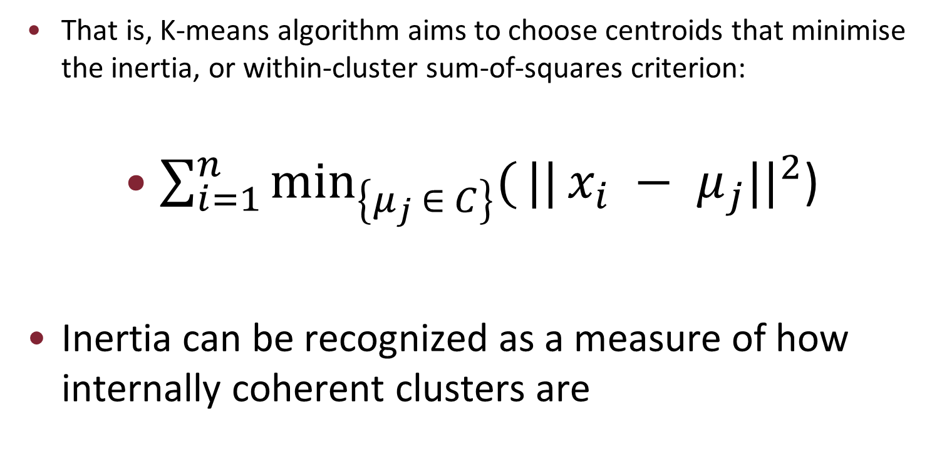
That is, K-means algorithm aims to choose centroids that minimise the inertia, or within-cluster sum-of-squares criterion:
$\sum_{i=1}^{n}{{\min_{\left\{μ_{j} ∈ C\right\}}({||}x_{i} − μ_{j}||}^{2}}$)
Inertia can be recognized as a measure of how internally coherent clusters are

Slide 17
The way kmeans algorithm works is as follows:
Specify number of clusters K.
Initialize centroids by first shuffling the dataset and then randomly selecting K data points for the centroids without replacement.
Keep iterating until there is no change to the centroids; i.e assignment of data points to clusters isn’t changing.
Compute the sum of the squared distance between data points and all centroids.
Assign each data point to the closest cluster (centroid).
Compute the centroids for the clusters by taking the average of all data points that belong to each cluster.

Slide 18
The approach k-means follows to solve the problem is called Expectation-Maximization.
The E-step is assigning the data points to the closest cluster.
The M-step is computing the centroid of each cluster.

Slide 19
k-means++
This algorithm ensures a smarter initialization of the centroids and "improves" the quality of the clustering.
Apart from initialization, the rest of the algorithm is the same as the standard K-means algorithm.
That is K-means++ is the standard K-means algorithm coupled with a smarter initialization of the centroids.
Still sensitive to outliers as we shall explain in a later section.

Slide 20
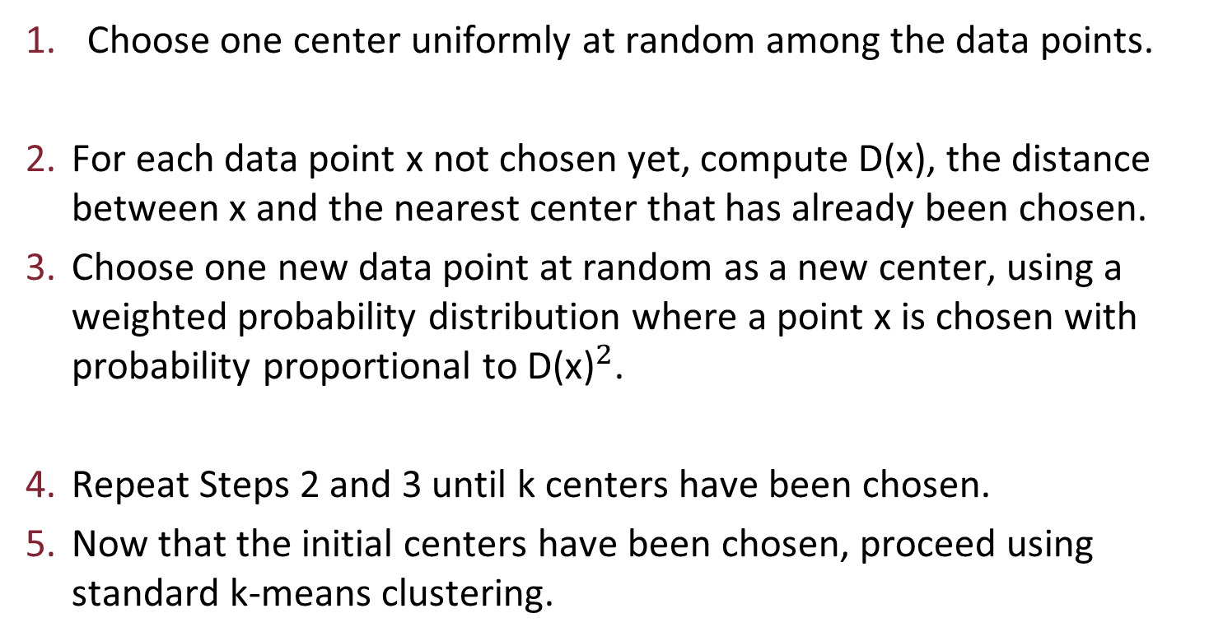
The algorithm in plain English:
Choose one center uniformly at random among the data points.
For each data point x not chosen yet, compute D(x), the distance between x and the nearest center that has already been chosen.
Choose one new data point at random as a new center, using a weighted probability distribution where a point x is chosen with probability proportional to ${\text{D}\text{(}\text{x}\text{)}}^{2}$.
Repeat Steps 2 and 3 until k centers have been chosen.
Now that the initial centers have been chosen, proceed using standard k-means clustering.

Slide 21
ELBOW CURVE
Let's see what the Elbow curve tells us about the appropriate number of clusters, we hope and expect this to be 4, because it would mean that those classes are "differentiated" and therefore our work to predict them using those features is meaningful.

Slide 22
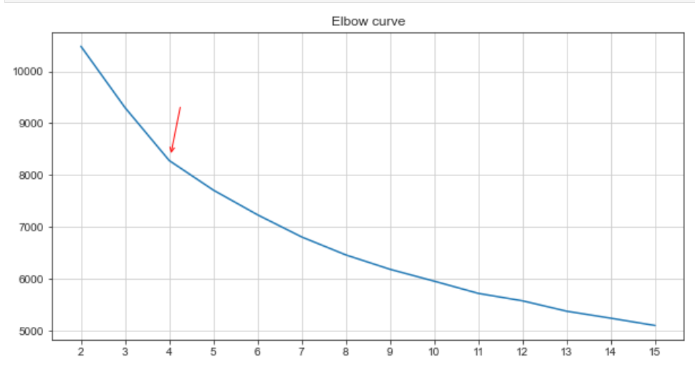
Even if it's not the most concise and strong curvature, we observe a great drop in dispersion when k = 4 with respect to 2 or 3, thus k=4 seems a fairly good choice for our dataset.

Slide 23
Confusion Matrix, Classification Report and Accuracy Score
We know that in real life scenarios we don't have the ground truth labels when dealing with unsupervised algorithm.
But for testing purpose, we come up with a kind of accuracy score for kmeans.
That is, after the algorithm has converged we compute the mode of the real labels in each cluster, and assign that cluster to represent that precise label, then compute the accuracy and confusion matrix according to that.

Slide 24
That is, a wrapper function of <Confusion Matrix, Accuracy Score and Classification Report> in order to get the true labels match the predicted labels. After the label matching, this function calls our earlier function called confusion_matrix_score.
With this, we do not need some sort of bipartite graph to get the matching done
The results are below.

Slide 25
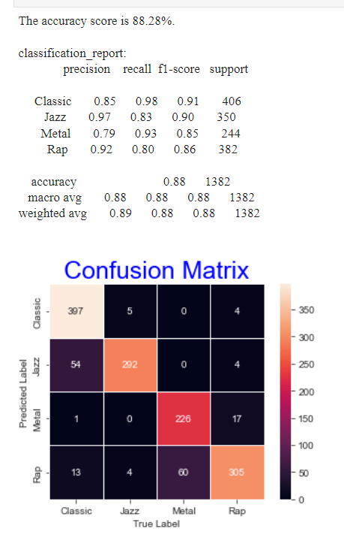
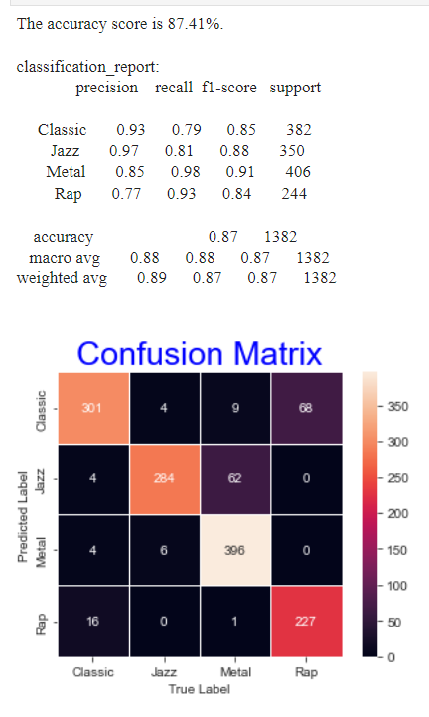
Sk-learn’s on the left and ours on the right

Slide 26
Clustering performance evaluation
Evaluating the performance of a clustering algorithm is not as trivial as counting the number of errors or the precision and recall of a supervised classification algorithm.
In particular any evaluation metric should not take the absolute values of the cluster labels into account but rather if this clustering define separations of the data similar to some ground truth set of classes or satisfying some assumption such that members belong to the same class are more similar than members of different classes according to some similarity metric.

Slide 27
How can one measure clustering goodness of fit?
Supervised algorithms have lots of metrics to check their goodness of fit like accuracy, r-square value, sensitivity, specificity etc. but what can we calculate to measure the accuracy or goodness of our clustering technique?
The answer to this question is Silhouette Coefficient or Silhouette score.
We can also use the silhouette score to check the optimal number of clusters.

Slide 28
Silhouette Coefficient
Silhouette score for a set of sample data points is used to measure how dense and well-separated the clusters are.
If the ground truth labels are not known, evaluation must be performed using the model itself. The Silhouette Coefficient is an example of such an evaluation, where a higher Silhouette Coefficient score relates to a model with better defined clusters.
The Silhouette Coefficient is defined for each sample and is composed of two scores:

Slide 29
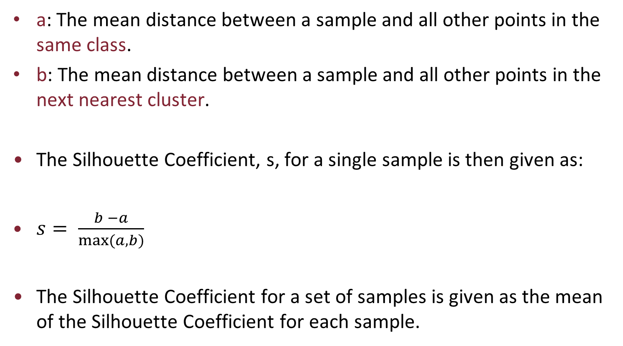
a: The mean distance between a sample and all other points in the same class.
b: The mean distance between a sample and all other points in the next nearest cluster.
The Silhouette Coefficient, s, for a single sample is then given as:
$s= \frac{b −a}{max⁡(a, b)}$
The Silhouette Coefficient for a set of samples is given as the mean of the Silhouette Coefficient for each sample.

Slide 30
Silhouette coefficients (as these values are referred to as) near +1 indicate that the sample is far away from the neighboring clusters. A value of 0 indicates that the sample is on or very close to the decision boundary between two neighboring clusters and negative values indicate that those samples might have been assigned to the wrong cluster.
With our this model, the silhouette score is 0.22.
Which implies that the samples are separated but might not be far away from their nearest neighboring clusters.

Slide 31
Note that Silhouette Coefficient is only defined if number of labels is 2 <= n_labels <= n_samples - 1.
The score is higher when clusters are dense and well separated, which relates to a standard concept of a cluster.

Slide 32
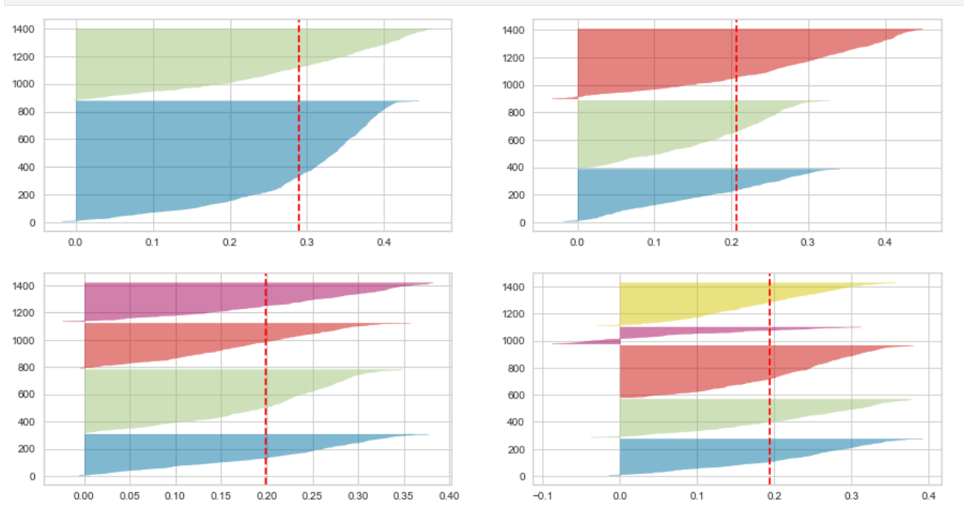
Silhouette Score’s Plot
K =2 in top left, k=3 in top right, k=4 in bottom left and k=5 in bottom right

Slide 33
Silhouette Plot Analysis
We proceed with a quick Silhouette analysis done on the above plots to select an optimal value for the number of clusters.
The number of clusters 2 and 5 look non-optimal for the given data due to the following reasons:
A large presence of samples with negative Silhouette Score (for k = 5)
Wide fluctuations in the size of the silhouette plots (for k = 2 and k = 5)
In conclusion 3 and 4 clusters are a better choice in our opinion, and we are glad for it since our dataset is actually divided into 4 categories.

Slide 34
Comparison between kmeans'
We do not seek to compare kmeans and kmeans++ because, unlike kmeans furthest first, they are both entirely random.
After randomly choosing first centroid, kmeans++ chooses the other k-1 centroids by giving more weight to far away points than nearby ones, which makes it more sensitive to outliers than the general kmeans.
However, since it was developed as an improvement over kmeans, it does often a better clustering than kmeans.

Slide 35
That is, far away points get large probabilities, but the probabilities of the nearby ones summed together may be large. So the sample can take any according to their proportions.
One may wonder whether or not kmeans furthest first always does a better job in clustering than kmeans. The answer is that kmeans furthest first does not always outperform kmeans.
A plot would help to better understand. So let's see some plots below.

Slide 36
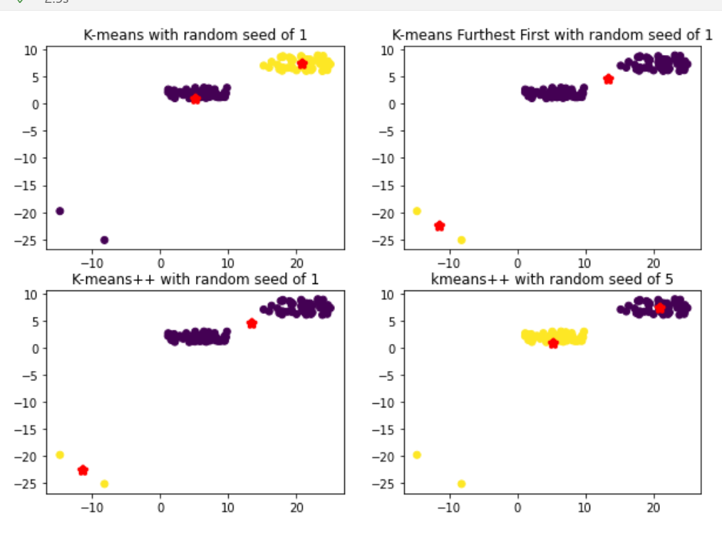

Slide 37
From this toy example, when k=2, kmeans clusters the data better.
However, for other k values, either Kmeans Furthest First outperforms it or they are on a par with each other.
Therefore, We can conclude that Kmeans Furthest First is sensitive to outliers and does not always outperform kmeans.

Slide 38
Mixture of Gaussians
A GMM is a parametric probability density function rapresented as a weighted sum of its k components.
That is, a Gaussian mixture model is a probabilistic model that assumes all the data points are generated from a mixture of a finite number of Gaussian distributions with unknown parameters. One can think of mixture models as generalizing k-means clustering to incorporate information about the covariance structure of the data as well as the centers of the latent Gaussians.

Slide 39
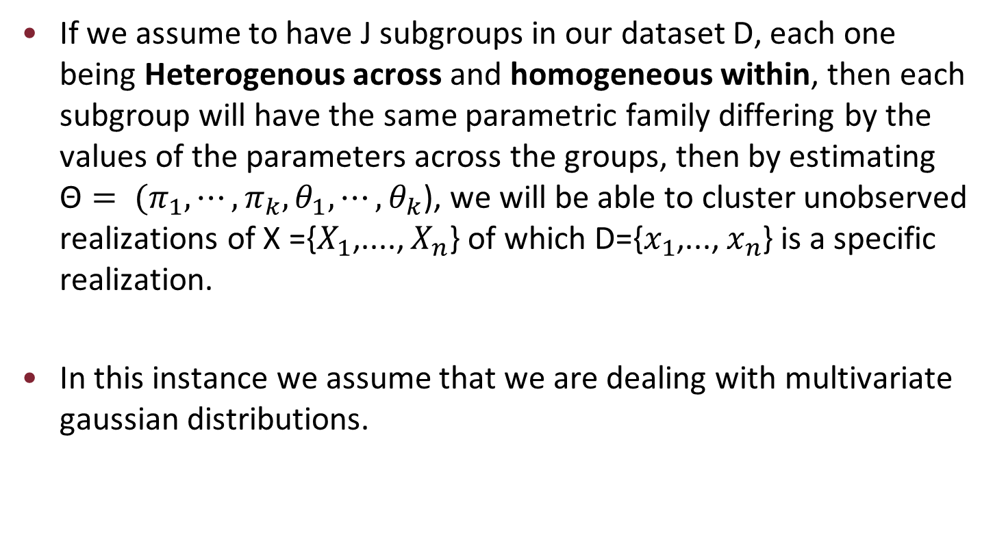
If we assume to have J subgroups in our dataset D, each one being Heterogenous across and homogeneous within, then each subgroup will have the same parametric family differing by the values of the parameters across the groups, then by estimating ${\text{Θ}= (π}_{1}, ⋯, π_{k}, θ_{1}, ⋯, θ_{k}$), we will be able to cluster unobserved realizations of X ={$X_{1}$,...., $X_{n}$} of which D={$x_{1}$,..., $x_{n}$} is a specific realization.
In this instance we assume that we are dealing with multivariate gaussian distributions.

Slide 40
EM Algorithm of GMM
So to the question on how to estimate the parameters, trying to estimate the parameters is NP given that the Log-likelihood is not jointly concave w.r.t- the mixture parameters.
Luckily we can use the Expectation Maximization Algorithm for finding the maximum likelihood estimates of a mixture (of gaussians in our case) model.
As the name suggests ,the algorithm is divided in two steps.

Slide 41
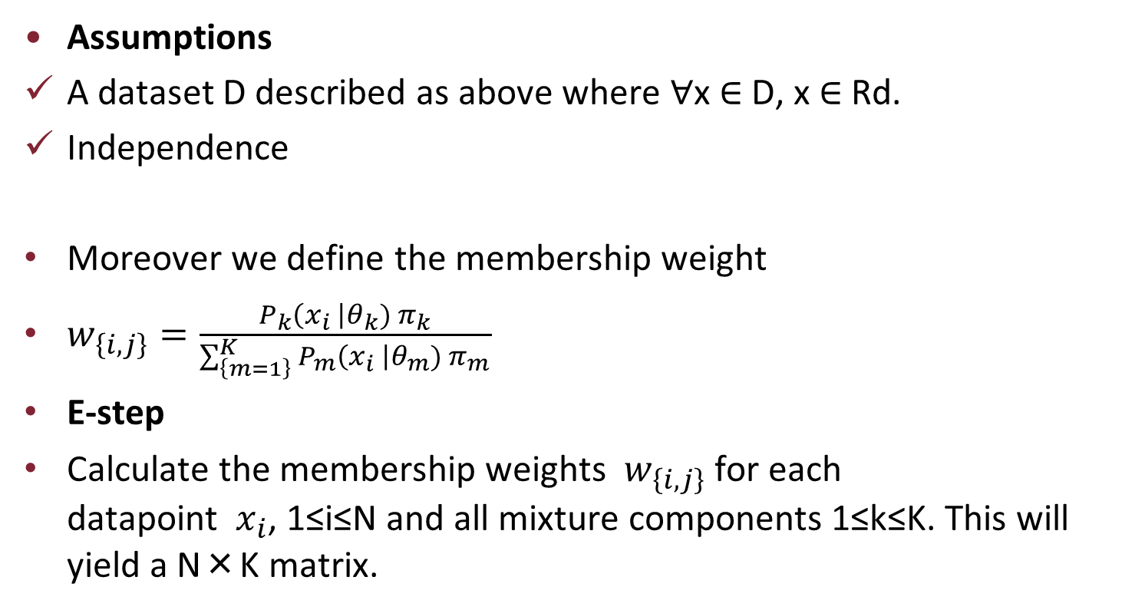
Assumptions
A dataset D described as above where ∀x ∈ D, x ∈ Rd.
Independence
Moreover we define the membership weight
$w_{\left\{i,j\right\}}=\frac{P_{k}\left(x_{i} \right|θ_{k}) π_{k}}{\sum_{\left\{m=1\right\}}^{K}{P_{m}\left(x_{i} \right|θ_{m}) π_{m}}}$
E-step
Calculate the membership weights $w_{\left\{i,j\right\}}$for each datapoint $x_{i}$, 1≤i≤N and all mixture components 1≤k≤K. This will yield a N×K matrix.

Slide 42
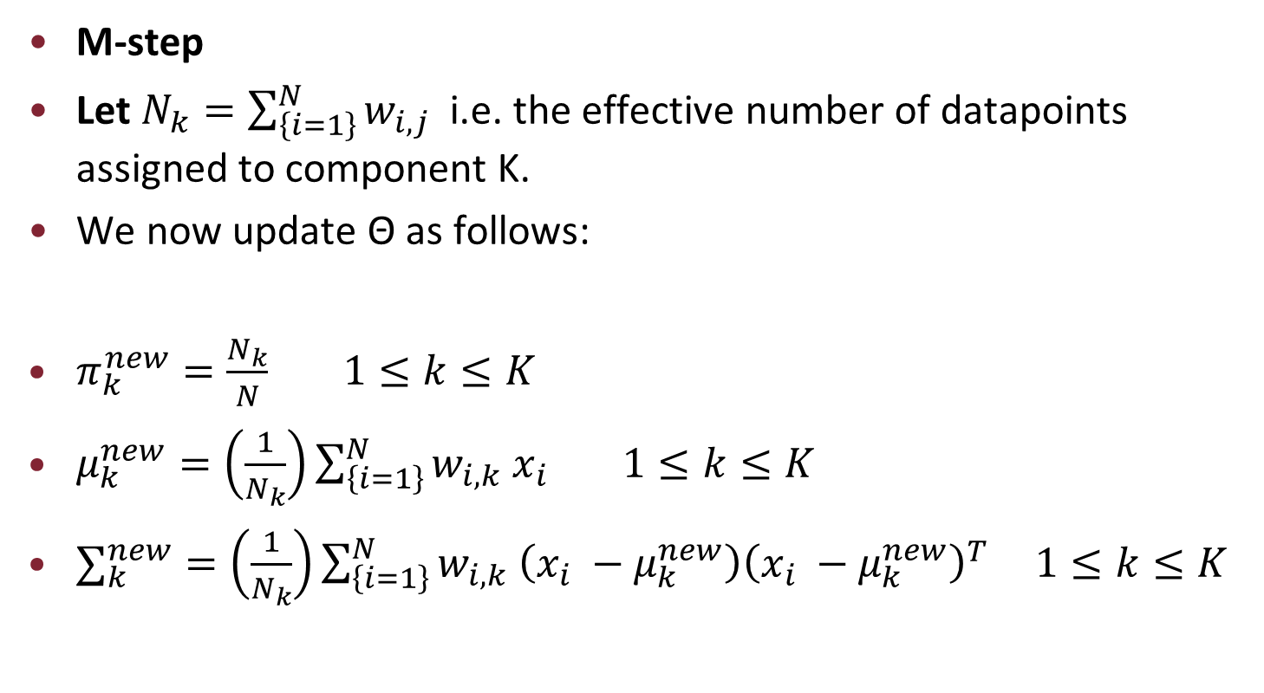
M-step
Let $N_{k}=\sum_{\left\{i=1\right\}}^{N}{w_{i,j}}$ i.e. the effective number of datapoints assigned to component K.
We now update Θ as follows:
$π_{k}^{new}=\frac{N_{k}}{N} 1≤k≤K$
$μ_{k}^{new}=\left(\frac{1}{N_{k}}\right)\sum_{\left\{i=1\right\}}^{N}{w_{i,k} x_{i}} 1≤k≤K$
$∑_{k}^{new}=\left(\frac{1}{N_{k}}\right)\sum_{\left\{i=1\right\}}^{N}{w_{i,k} \left(x_{i} −μ_{k}^{new}\right){\left(x_{i} −μ_{k}^{new}\right)}^{T} } 1≤k≤K$

Slide 43
Convergence
The algorithm takes an iterative approach where in each iteration the M-step is ran after the E-step. But how do we decide when to stop the iterations?
One approach is to limit the amount of iterations a priori.
A better approach is to calculate at each iteration the value of the log likelihood and stop the algorithm when no appreaciable improvement is gained w.r.t to the previous iteration.
Note that EM does not guarantee to converge neither to a global or local minima.

Slide 44
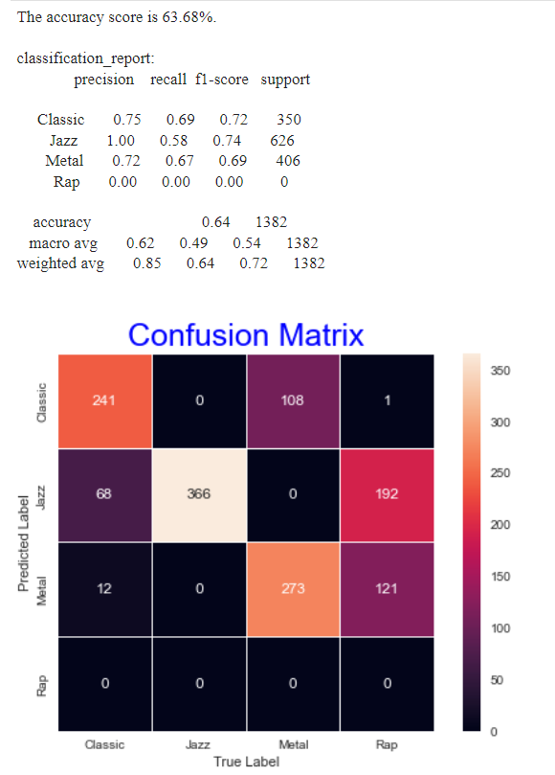
GMM Confusion Matrix, Classification Report and Score
With this dataset, kmeans does surely a better work with respect to GMM.
Those unsupervised methods gave us some interesting outcomes, but now it's time to go back to our original line of thought and try to predict the class having a labelled dateset. Let's discover what the world of Supervised Models can achieve

Slide 45
Naive Bayes Classifier
Naive Bayes is a simple technique for constructing classifiers: models that assign class labels to problem instances, represented as vectors of feature values, where the class labels are drawn from some finite set.
There is not a single algorithm for training such classifiers, but a family of algorithms based on a common principle: all naive Bayes classifiers assume that the value of a particular feature is independent of the value of any other feature, given the class variable.

Slide 46
For example, a fruit may be considered to be an apple if it is red, round, and about 10 cm in diameter.
A naive Bayes classifier considers each of these features to contribute independently to the probability that this fruit is an apple, regardless of any possible correlations between the color, roundness, and diameter features.
Abstractly, naive Bayes is a conditional probability model: given a problem instance to be classified, represented by a vector x=(x1,…,xn) representing some n features (independent variables), it assigns to this instance probabilities P(C_k | x1, …, xn)
for each of K possible outcomes or classes C_k

Slide 47
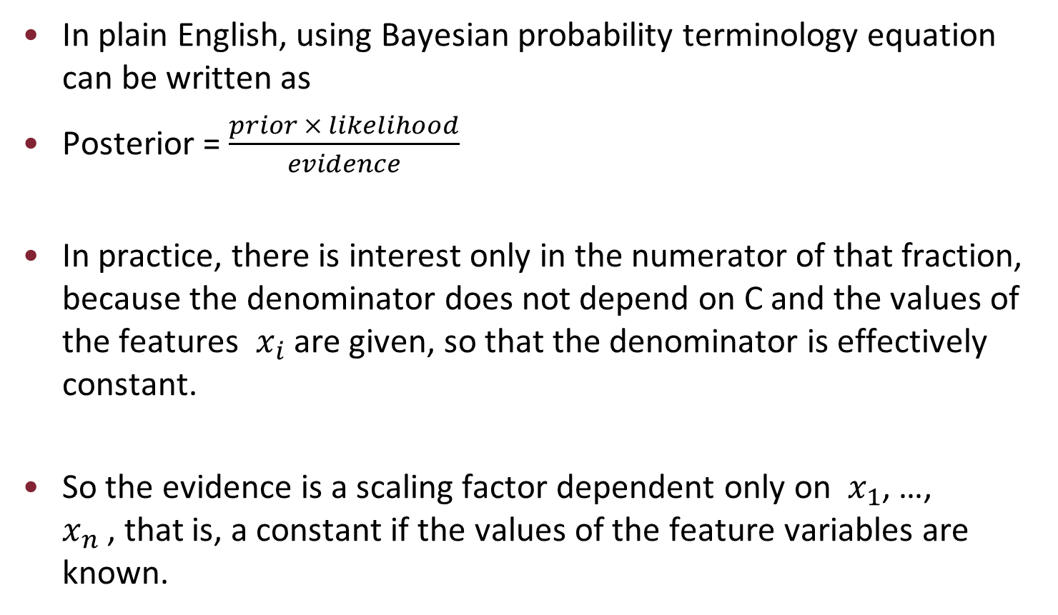
In plain English, using Bayesian probability terminology equation can be written as
Posterior = $\frac{prior × likelihood}{evidence}$
In practice, there is interest only in the numerator of that fraction, because the denominator does not depend on C and the values of the features $x_{i}$are given, so that the denominator is effectively constant.
So the evidence is a scaling factor dependent only on $x_{1}$, …, $x_{n}$, that is, a constant if the values of the feature variables are known.

Slide 48
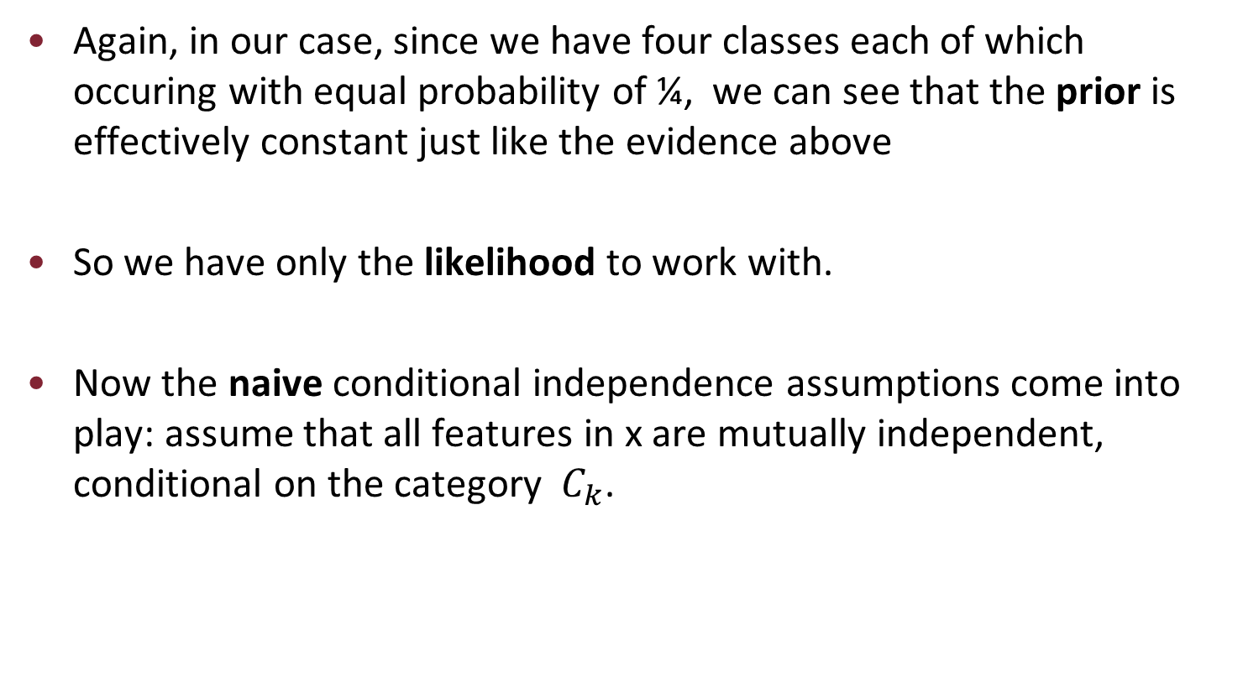
Again, in our case, since we have four classes each of which occuring with equal probability of ¼, we can see that the prior is effectively constant just like the evidence above
So we have only the likelihood to work with.
Now the naive conditional independence assumptions come into play: assume that all features in x are mutually independent, conditional on the category $C_{k}$.

Slide 49
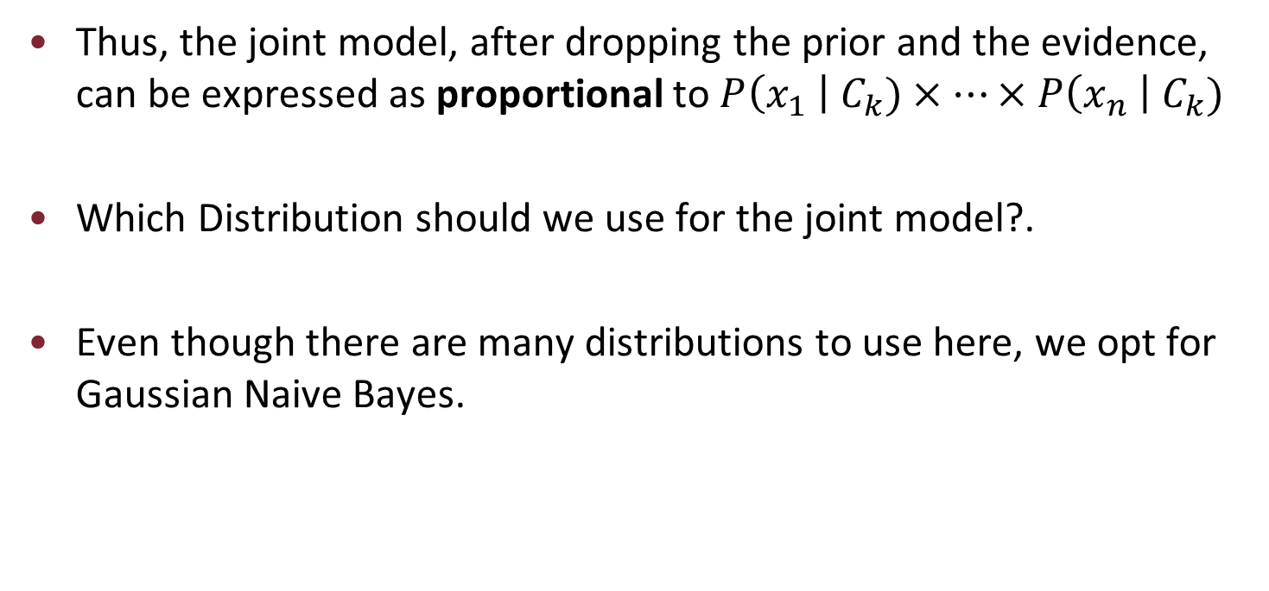
Thus, the joint model, after dropping the prior and the evidence, can be expressed as proportional to $P\left(x_{1} \right| C_{k})×⋯×P\left(x_{n} \right| C_{k})$
Which Distribution should we use for the joint model?.
Even though there are many distributions to use here, we opt for Gaussian Naive Bayes.

Slide 50
Gaussian Naive Bayes
When dealing with continuous data, a typical assumption is that the continuous values associated with each class are distributed according to a normal (or Gaussian) distribution.
For example, suppose the training data contains a continuous attribute, x.
The data is first segmented by the class, and then the mean and variance of x is computed in each class.

Slide 51
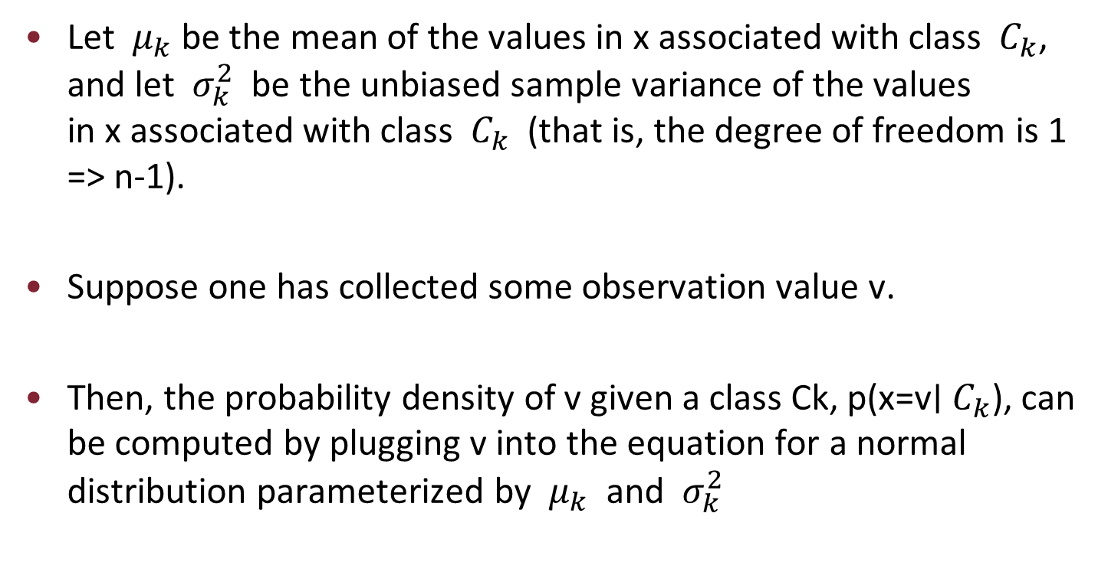
Let $μ_{k}$be the mean of the values in x associated with class $C_{k}$, and let $σ_{k}^{2}$ be the unbiased sample variance of the values in x associated with class $C_{k}$ (that is, the degree of freedom is 1 => n-1).
Suppose one has collected some observation value v.
Then, the probability density of v given a class Ck, p(x=v∣ $C_{k}$), can be computed by plugging v into the equation for a normal distribution parameterized by $μ_{k}$ and $σ_{k}^{2}$

Slide 52
In order to classify samples, one has to determine which posterior is greater: classic, jazz, metal or rap.
We use the negative log-likelihood since the product of a large number of small probabilities can easily underflow the numerical precision of the computer.
This is resolved by computing instead the sum of the negative log probabilities.

Slide 53
The best estimate for the mean and variance parameters of a Gaussian are simply the empirical estimates of the mean and variance respectively.
These means and variances are for each feature w.r.t each class.
For example, the feature danceability w.r.t rap has a mean and variance different than danceability w.r.t classic.
So for each feature x, it has a mean and variance for each class c.

Slide 54
Therefore, the means and variances must be calculated for each feature (in our case, a whopping 12 features for 4 classes).
We did this in a simple one-pass by first filtering out the appropriate instances (w.r.t to the class in question) under each feature, then take the mean and variance as can be seen in the implementation.

Slide 55
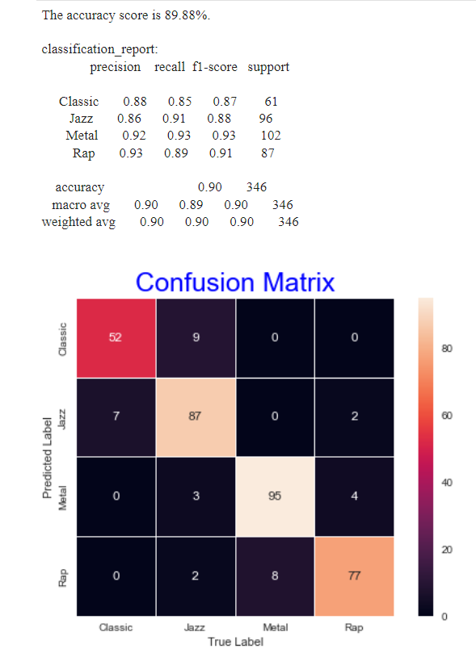
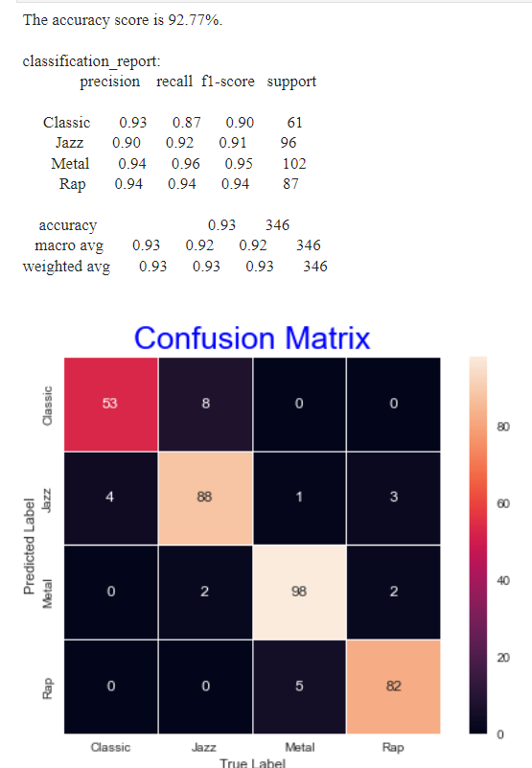
Confusion Matrix, Classification Report and Accuracy Score
Ours on the left and sk-learn’s on the right

Slide 56
Popularity of a song
The Spotify for Developers API provide also another type of data: a track's popularity.
Using the track "id" we can retrieve, with a little code, the actual popularity value for that particular track, and add these data into our dataset.
But how do you quantify the popularity of a song?
According to Spotify, “The popularity of a track is a value between 0 and 100, with 100 being the most popular.

Slide 57
The popularity is calculated by an algorithm and is based, in the most part, on the total number of plays the track has had and how recent those plays are.
Generally speaking, songs that are being played a lot now will have a higher popularity than songs that were played a lot in the past.”
We think this value is also used for music recommendation and to build the various "Trend" playlists.
So maybe it would be cool to look how things change if we create a dataset with very popular songs, to see what they have in common or if there is any pattern.

Slide 58
The "Top50_clean.csv" dataset contains a set of the currently Top50 most popular songs from any country we have found on spotify. Basically we merged together the data from "Top50 Italia", "Top50 France" "Top50 Australia" and so on and so forth.
Therefore now we have 2 datasets, the one with genres label, and the Top50 one. Let's now explore a few plots and visualizations.
We are curious to see what the popularity distribution is across the dataset.

Slide 59
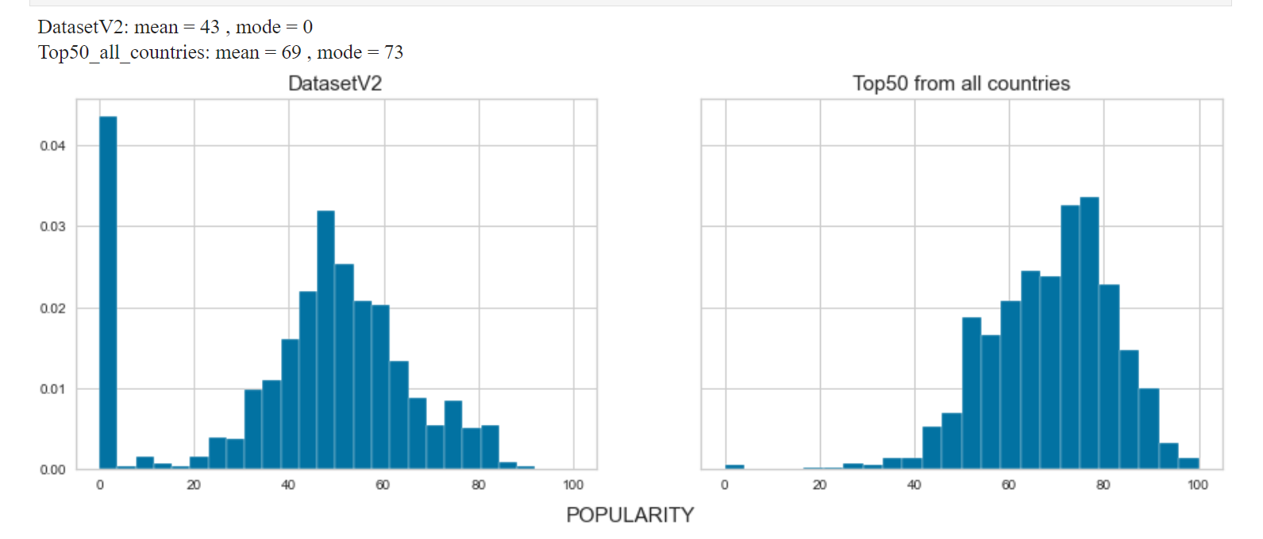

Slide 60
If we look at the leftmost histogram, the one about the almost "popularity unbiased" dataset, we see a right skewed distribution showing us how truly rare it is to have popular song.
Looking at the right plot, with no surprise since we took the trending songs of various countries, we see a distribution centered near high values of popularity.
Let's now have a look to some statistics of about popular songs:

Slide 61
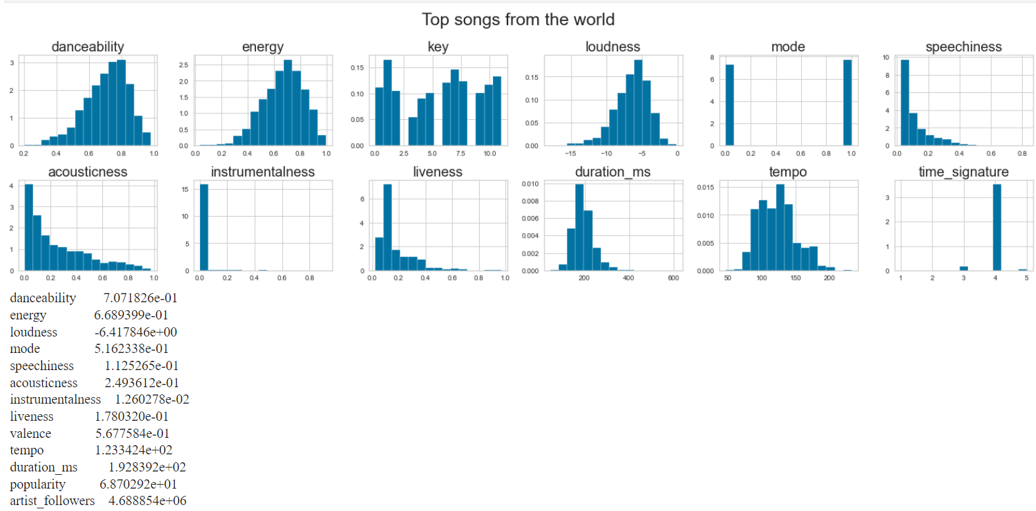

Slide 62
Since we have a little background knowledge about music, we have noticed a few interesting things :
The most common duration among trending songs is more or less 3 minute and 30 seconds, that matches with the usual Radio's songs duration. From internet: "In general, a radio-ready song is one that is three minutes, give or take 30 seconds". The mean is indeed around 3 minutes.
We have 3 modes for the Tempo: 95 bpm, 120 bmp and 140 bpm. Those are indeed the most used Tempo in Western music. If we want to make a (statistically insignificant) example, "Shape of you" by Ed Sheeran, "Sweet Child of Mine" by Guns N' Roses and "Beat It" by Michael Jackson are played with 95,120 and 140 bpm respectively, according to a bunch of websites.

Slide 63
A very common time signature is 4/4, which in music theory is indeed the basic and default time signature, also the easiest one to play and follows instrumentically.
People like high-energy songs, better if they can dance on it (see danceability and energy mean), while they don't give much attention to vocal-free and acoustic pieces (see acousticness and instrumentalness)
Minor tone tracks and Major tone tracks don't show any significance difference in term of popularity.

Slide 64
A fair question now is: is there any connection between our features and the popolarity of a song?
Well, as initial guess (spoiler alert) we don't expect too much dependeces since how much a track will be famous depends a lot about external factors, as the current fashion, events happening in the world, artist's importance and reputation, social-media stuff and advertisment and so on.
But let's see if we can come up with something notable.

Slide 65
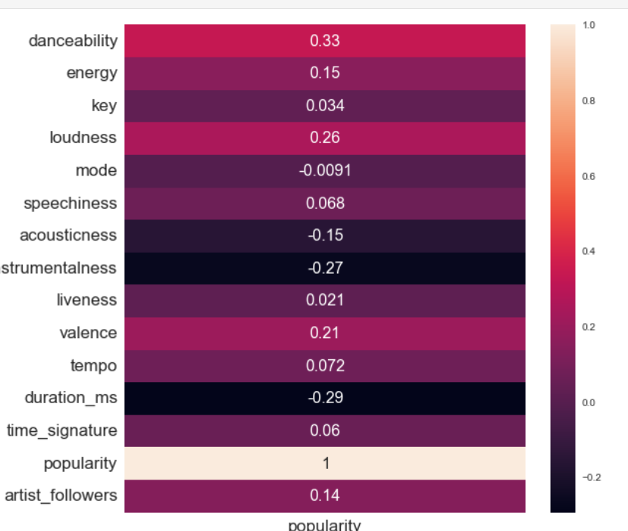
First of all, let’s look at a correlation table to identify some baseline correlations between our many X variables.
To do so we merge our two datasets onto one and see the results.

Slide 66
As expected, we can't see any strong correlation. The best results come with danceability, loudness, instrumentalness and duration. The latter is anticorrelated with a coefficient of -0.29.
Let's try to plot those features and see what a simple Linear Regression model looks like.
We'll use our Linear Regression class, implemented by scratch, to see how a line visually fits the data. The first row of subplots shows a classic linear regression, the second a polynomial regression of 4th degree. We then output the R2 coefficient and Mean Absolute Error of each fit.

Slide 67
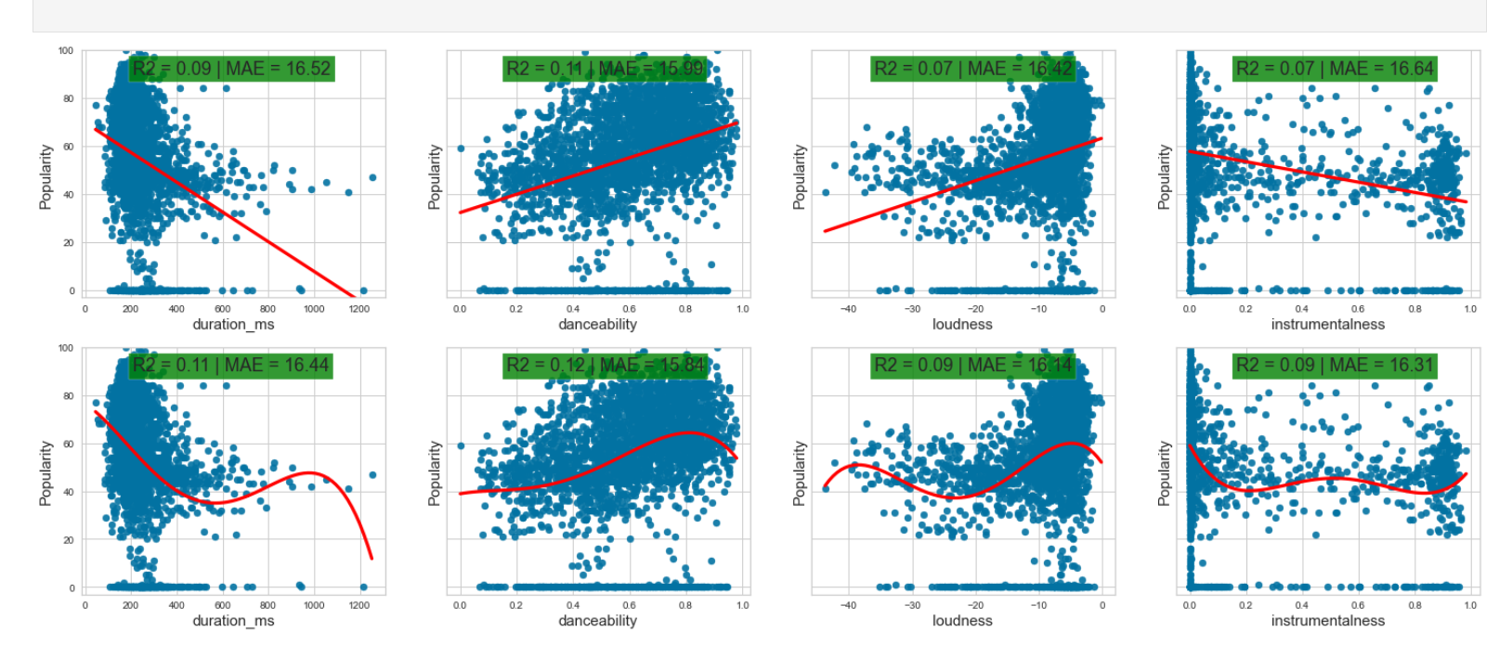
Regresion Plots of Popularity

Slide 68
The best result is the Polynomial Regression of 4th degree using the danceability of the track as explanatory variable with an R-squared coefficient of 0.12 and A Mean Absolute Error of 15.84.
An average of 15.84 spread for our residuals in the prediction model for a range of 0–100 in ‘popularity’ is huge. And also R2 is low.
Let's try adding a dimension.

Slide 69
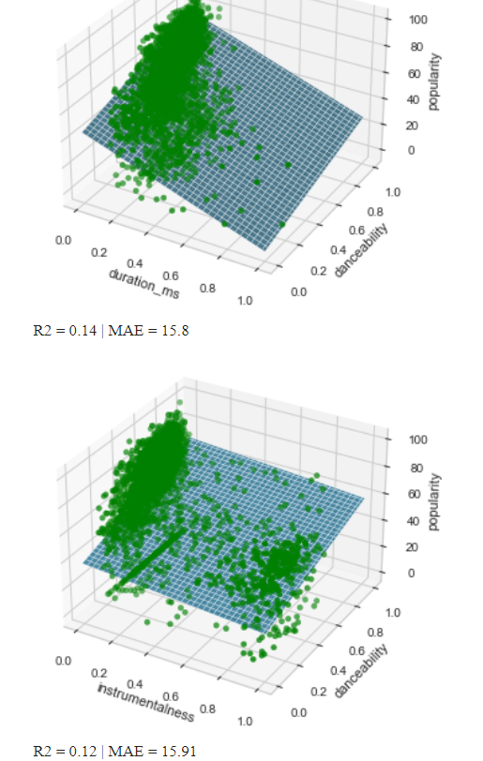
Things do not really seem to get better, our goal feature is probably not really linear correlated to the others.
So perhaps it’s time to see what the classification world could offer us.

Slide 70
Classification
In order to set up any classification model we have to move away from trying to predict a continuous integer value, and instead modelling classes/label.
So an idea could be to divide the 0 - 100 range of "popularity" into 3 sorted sections.
We created three bins that represent "low","medium","high" popularity using pandas.cut() and then split the dataset into training and test set with the help of Sklearn.

Slide 71
The first method we are willing to try is classification using a Decision Tree and of course a Random Forest to see how an ensemble method can perform in this scenario.
We used our python classes built from scratch and see what this models offered us with.
A single deterministic Decision Tree pops out an accuracy score of about 0.65.
So with the model we have a probability to get the label right that is twice as much as randomly choosing among 3 classes (33% if we casually pick one).

Slide 72
But it's still not great, we would prefer something around 80-90%, because we have to remember that we have created only 3 categories over a continous range of length 100.
For instance if we divide instead the dataset into 5,10,20 bins we'll see the accuracy dropping very fast.
With the Random Forest we don't see any major improvement, but since this method relies on Bootstrapping the result can change a bit over different code runs/random seeds.

Slide 73
Conclusion part

Slide 74
Our (and your) journey here is finally coming to an end.
We really had fun doing all of this statistical analysis and Data Science.
We have found nice curiosities about songs, genres, popularity and we have observed how different models and methods performs with this kind of real-world dataset.
But leaving back all the accademical purposes, we also think that a work of this type can be somehow adapted and used to build reccomendation systems, targeted advertising, trend and fashion analysis and other possible useful applications that a company can come out with

Slide 75
Also we are conscious that a huge amount of data are private and kept hiden by Spotify, since we have to remember it is still a multimillionarie dollars company.
Sum up below

Slide 76
Quick Sum-up
Our work dealt with the folowing:
Data statistics and visualizations: features
mean,
mode,
correlations,
scatterplot and histograms,
genres pecularities and similarities.

Slide 77
Clustering Algorithms:
Kmeans with different initializations such random, ++ , furthest first;
Gaussian Mixture models;
Evaluation metrics such as Elbow method, silhouette score and plots;
Classification models to predict the genre:
Gaussian Naïve Bayes,
Decision Trees and Random Forest

Slide 78
Regression and classification models to predict the popularity:
Linear/polynomial/multiple regression,
Decision Trees and Random Forest,
Logistic regression
It's been a fun and productive experience and we can't stop wondering how many other exciting studies we could do with extra data and time.
We hope it was also a pleasure for the readers to take a look at our elaborate.

Slide 79
Francesco Danese Yusupha Juwara Benjamin Barda
Thank you all for your kind attention

